Slide 1
EV Bus Technologies Update
Paul Koleber
Director of Fleet and Facilities Maintenance
April 17, 2019

Slide 2
New for 2019
2019 Gillig bus purchase update
Eight 35-foot BRT-styled buses
Delivery is underway!
Sixteen 40-foot BRT-styled buses
Production begins August 19th
2019 Dial-A-Lift (DAL) bus update
Seven gasoline-powered Eldorado DAL buses
Equipped with the necessary equipment so propane can be later added

Slide 3
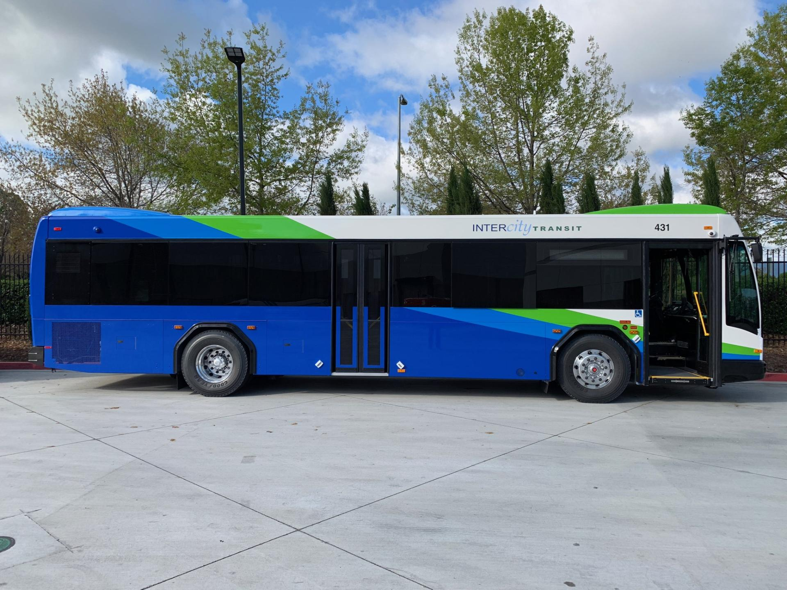

Slide 4
Electric Bus Update
Peer Agencies Currently Engaging EV
King County Metro -Seattle
Pierce Transit -Tacoma
LINK –Wenatchee
Whatcom -Bellingham
BFT -Richland
Valley Transit -Walla Walla
STA –Spokane
C-TRAN –Vancouver
Tri-Met –Portland
LTD -Eugene

Slide 5
King County Metro –Seattle, WA.
Eleven buses currently in service in Bellevue
Fast charge, short runs, ~25 miles per run
Originally tested Proterra, currently testing others
Testing six for slow charge with 140-mile range
Test buses not yet in service
Building a new satellite electric bus base

Slide 6
Pierce Transit –Tacoma, WA.
Purchased three Proterra buses and received them in November
Specified the highest capacity available
Placed into service on their shortest routes
Cold weather decreased range 20%
Range has been ~110-miles during less-than-warm months
Charge time ~six-hours per bus for 110-miles
Charger manufacturer has had several technical issues
Local utility is charging significantly more than planned
Proterra buses have had several technical issues
Received a grant to purchase three this year
Hoping to purchase Gillig EV

Slide 7
LINK –Wenatchee, WA.
Two BYD buses in service
Originally purchased five, but returned three to BYD
Hired BYD factory technician to keep buses in service
Reliability is slowly improving
Re-negotiating any possible future purchases

Slide 8
Whatcom Transit –Bellingham, WA.
Tested three Proterra buses on a lease program
Reliability, support and quality issues prompted them to return the buses back to Proterra long before the lease was up
Plan to go electric, but are awaiting the Gillig EV

Slide 9
Ben Franklin Transit –Richland, WA.
Ol’ Sparky
Complete Coach Works 40-foot conversion to electric drive
Heat and cold severely affects range
Typically not in use in regular service. Is used for school tours and special events
Planning to purchase two new EV in the near future
Hoping to purchase Gillig EV

Slide 10
Valley Transit –Walla Walla, WA.
Ordered four BYD buses in 2017, still not in service
Two at the trolley conversion facility
One in storage
One still at BYD with roof removed
Trolley conversion provider found interior, roof and structure issues with roof coming loose and buckling
‘BYD has no parts department, has provided no manuals or schematics, and takes four months to return a call’
VT is having to engineer their own charging solutions because state inspector would not sign off on BYD solutions
Hoping BYD bus will go ~120 miles, if they ever get one running
Suggested calling back later this summer to see if one ever goes into service

Slide 11
STA –Spokane, WA.
Plans are being made to go to EV
Currently performing a system evaluation
Sorta-kinda grant dependent plan is to purchase:
Ten 40’ EV in 2020
Ten 60’ articulated EV buses in 2021
Six 40’ EV in 2023

Slide 12
C-TRAN –Vancouver, WA
Looking into purchasing four EV in third-quarter 2019
Hoping to get Gillig EV

Slide 13
Tri-Met –Portland, OR.
Purchased three New-Flyer EV buses
Significant fit and finish issues
Re-negotiated the warranty before agreement to keep the buses
No future New Flyer plans
Awaiting Gillig’s EV bus

Slide 14
LTD –Eugene, OR.
Have two BYD buses; one is in service
Two-three year process to get one bus in service
‘Never again will we buy BYD’
‘Has been a complete and total nightmare’
‘Forced to use depreciated contingency buses to meet service expansion demands’
Long term plan is to go EV, but now have to rethink the how

Slide 15
Our Strategy
Continue to learn from peer agencies
Continue to track evolution of battery technologies
Continue to track Gillig’s new EV products
Continue to seek success stories in EV
Currently there are none

