Slide 1
Arts Walk at Walk N Roll

Slide 2
AmeriCorps Service Project
Every AmeriCorps Member has a Service Project
Engage community, create opportunity for volunteerism
Find something new

Slide 3
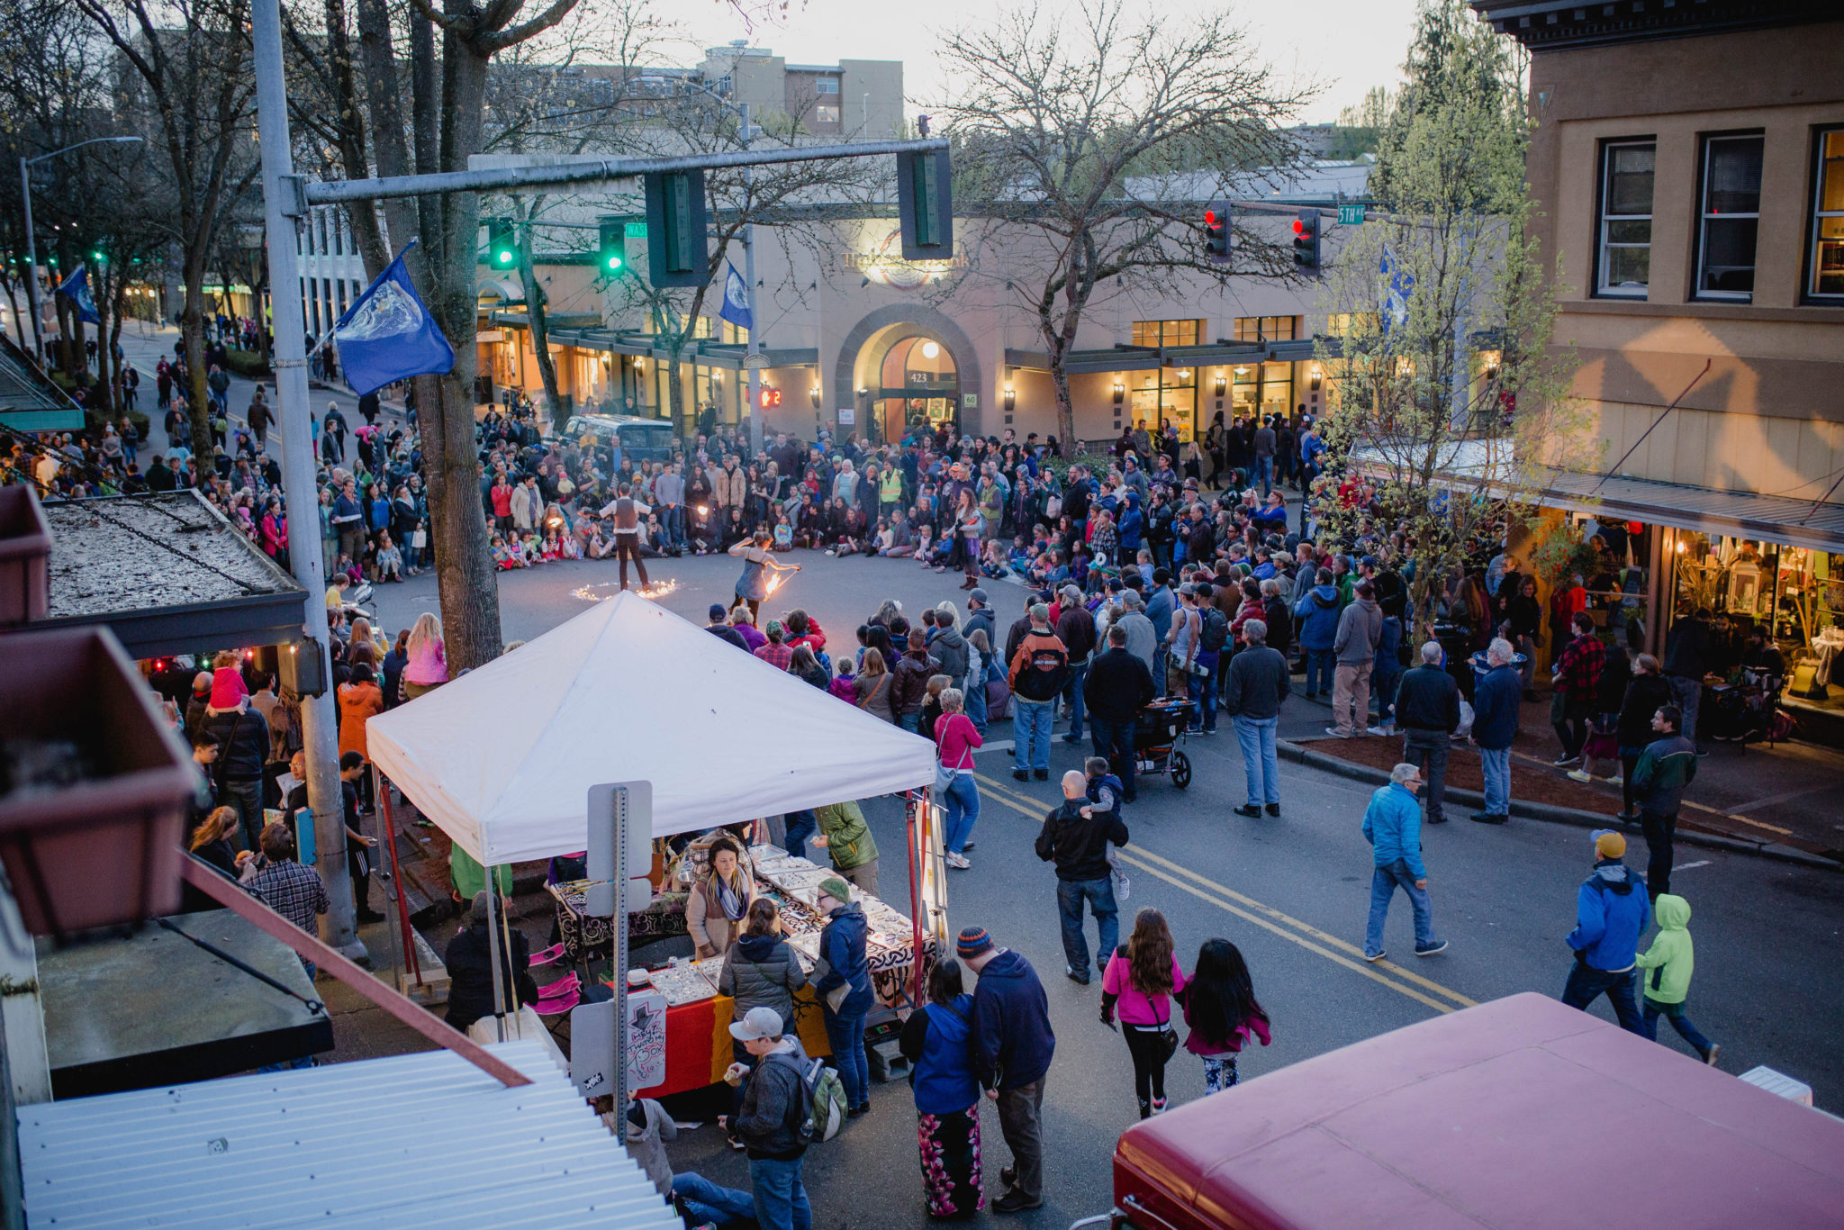

Slide 5
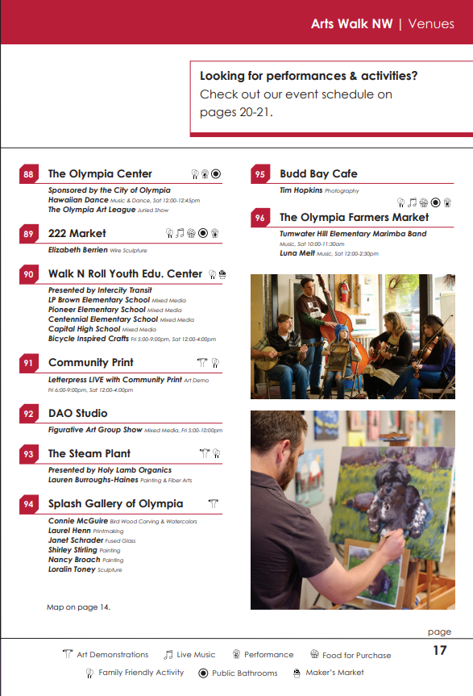

Slide 6
Friday 26th 5-10 Saturday 27th 12-8

