Slide 1

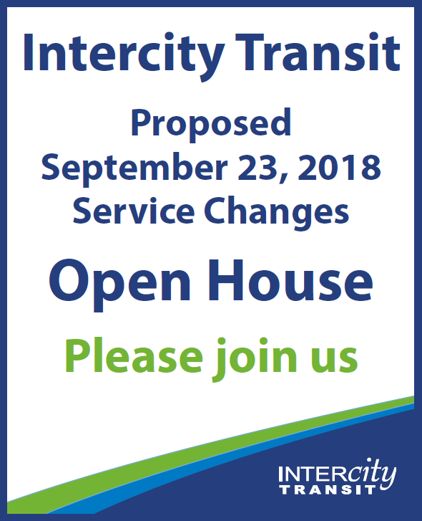
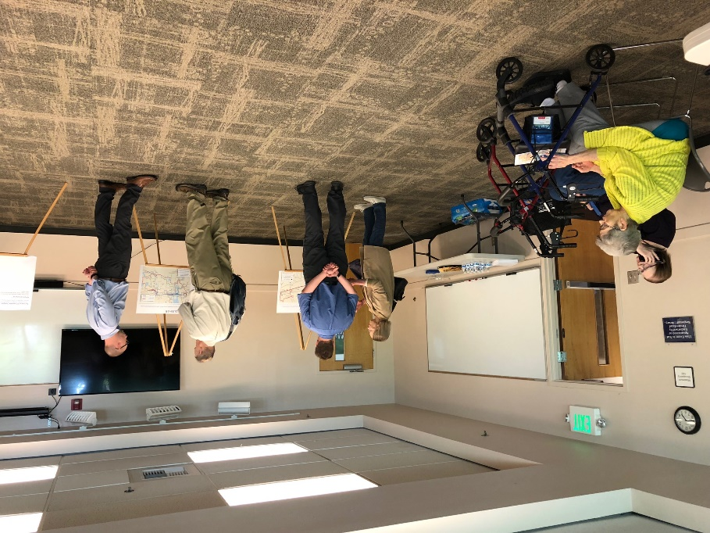
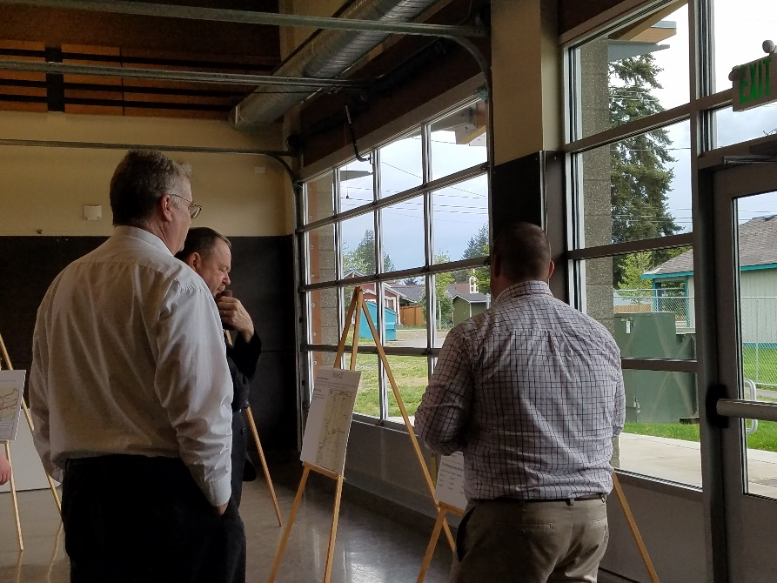
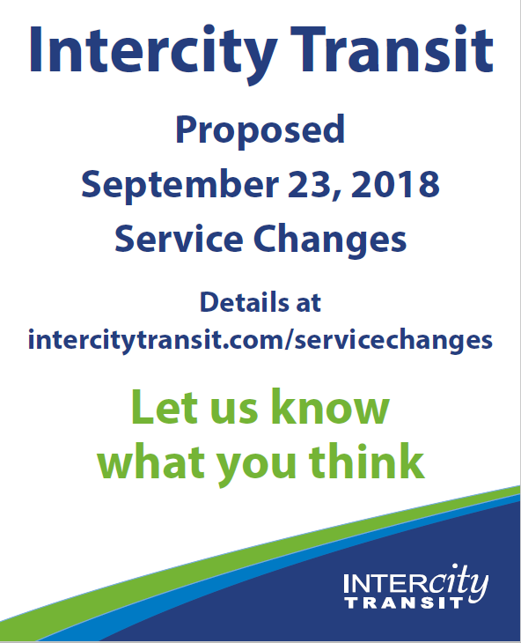
1
2
3
4
5
6
Concepts
Proposal
Public Outreach
Review
Final
Adoption
Implementation
An update on the Service Change proposal

Slide 2
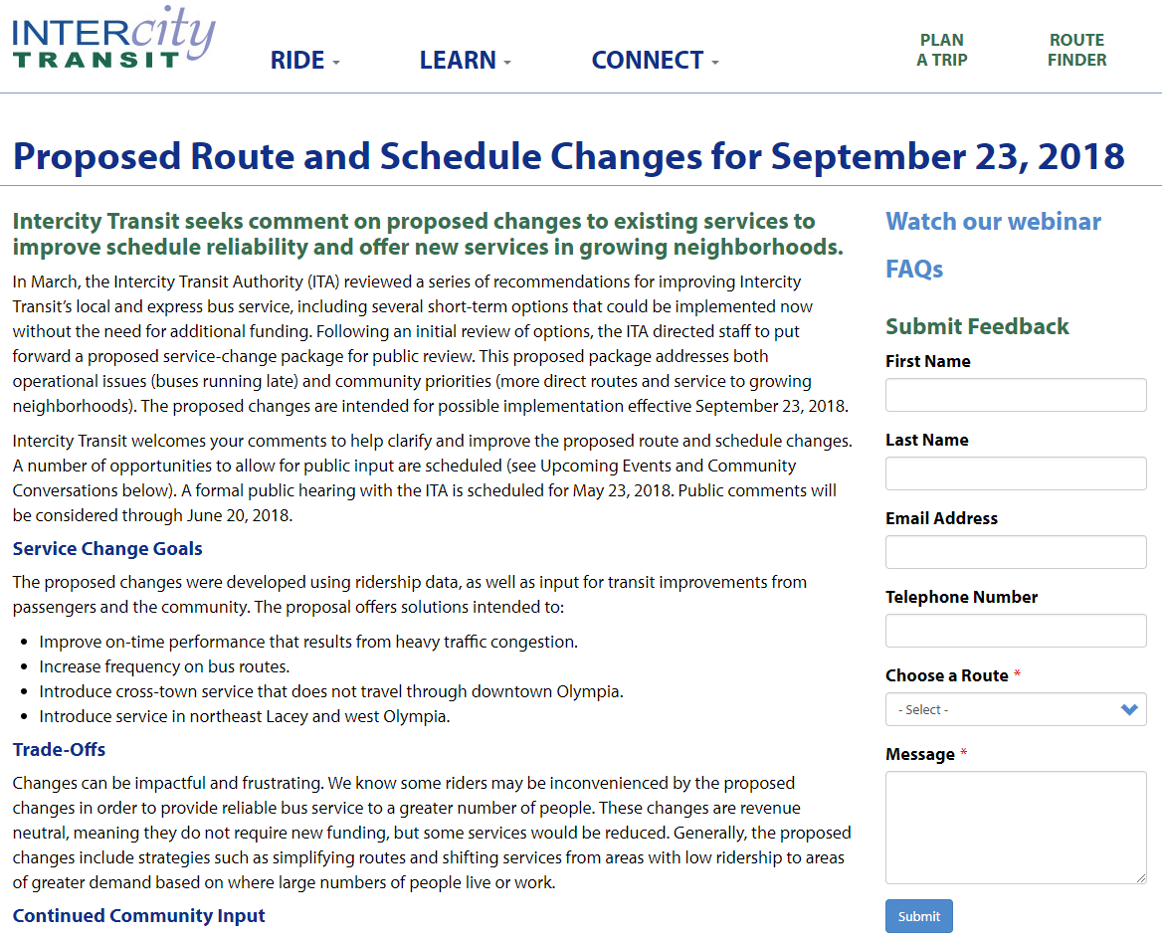
Outreach Review
Website
Special Rider News
Media Release
4 Open Houses
8 Passenger Intercepts
Webinar

Slide 3
12
42
47
60
62
68
94
612
620

Slide 4
So what does all of this mean?

Slide 5
A Second look
Amendments to the Existing Proposal
In response to public outreach and additional research, staff is recommending 3 amendments to the proposal:
Route 612 (Olympia Express) – Maintain service at the Tacoma Dome Station, but discontinue service between Tacoma Dome Station and 10th & Commerce.
Route 45 – Modify the route to add service on Harrison Ave, Kaiser Rd and Capital Mall Dr (complement Route 47)
Route 41 – Discontinue the 10 weekday trips that operate between The Evergreen State College and Olympia Transit Center during the school year which increase frequency from 30 minutes to 15 minutes during the AM/PM peak period.

Slide 6
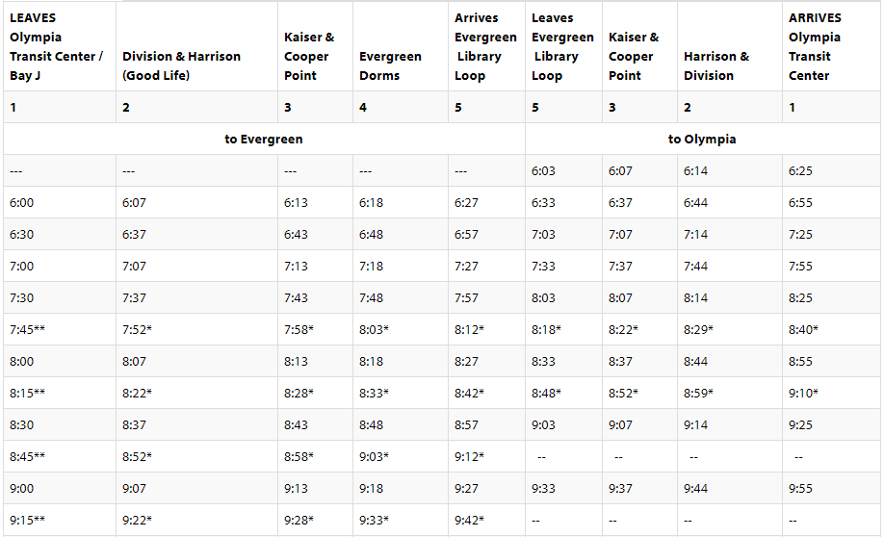
Routes 41 & 45
Fixed Route service in west Olympia
Route 41
“AM Trippers”

Slide 7
Next Steps
April 16th – CAC Review
April 18th – Authority approves release for public comment
April 23rd – Public outreach process begins
May 21st – CAC update
May 23rd – Public Hearing
June 6th – Authority update
June 20th – Authority update
July 16th – CAC update
July 18th – ITA consideration of Final Adoption
July 19th to September 22nd – Staff prepares for implementation
September 23rd – Service change implementation date

